Slide 1





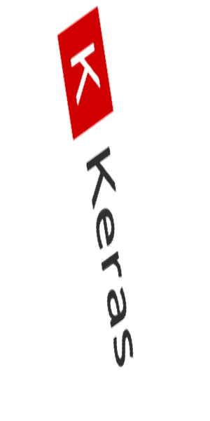

>Optimising Training of Neural Networks_
>Optimising Training of Neural Networks_
deep Science !
deep Code ...
# Joinal Ahmed
Notes:
Abstract: Google has recently open-sourced its framework for machine learning and neural networks called Tensorflow. With this new tool, deep machine learning transitions from an area of research into mainstream software engineering. In this session, we will teach you how to choose the right neural network for your problem and how to make it behave. Familiarity with differential equations is no longer required. Instead, a couple of lines of Tensorflow Python, and a bag of "tricks of the trade" will do the job.
No previous Python knowledge required.
__________________________________________________________________________
All cartoon images copyright: alexpokusay / 123RF stock photos

Slide 2
Recap till now
Introduction to Neural Networks & its working
Tensorflow framework
Introduction to Neural Networks for Regression Problems
Introduction to Neural Networks for Classification Problems
Introduction to Hyperparameters (epochs, learning rate, batch size)
Basics of optimization

Slide 3
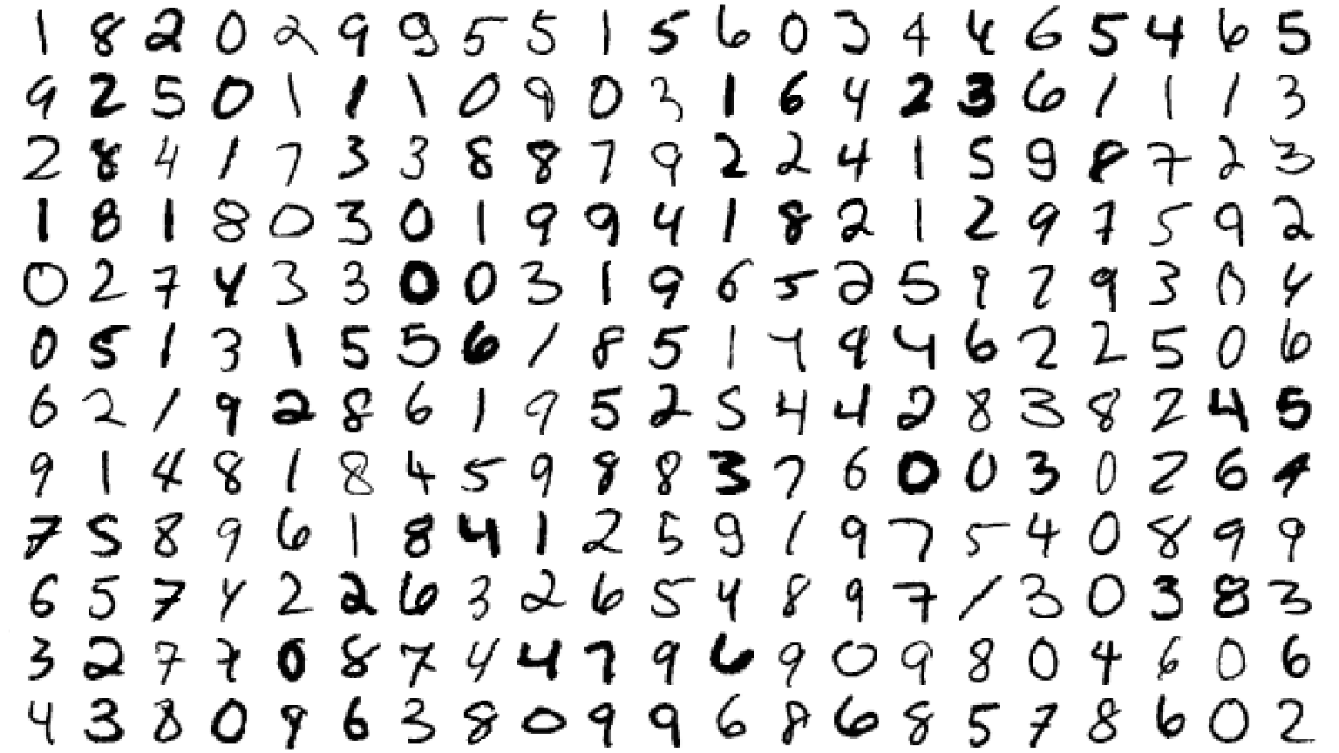

Hello World: handwritten digits classification - MNIST
??
MNIST = Mixed National Institute of Standards and Technology - Download the dataset at http://yann.lecun.com/exdb/mnist/
Notes:
The MNIST dataset contains 60,000 handwritten digits labeled with their correct meaning. This dataset can be downloaded from: http://yann.lecun.com/exdb/mnist/

Slide 4
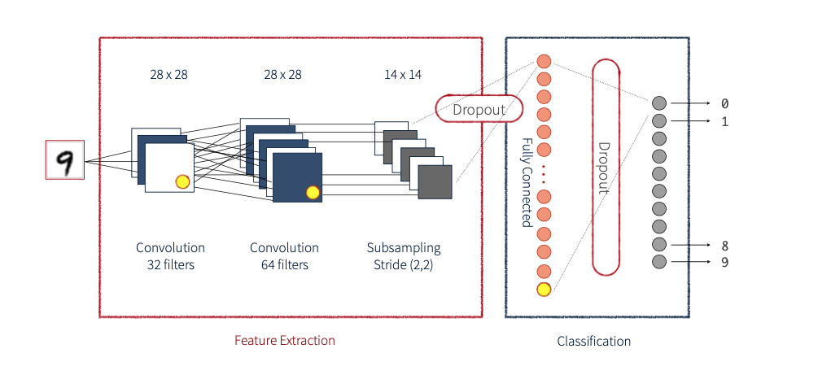
Convolutional Neural Networks
Notes:
Neuron inputs = weighted sum of pixels + biases
Neuron outputs = normalised exponential of inputs (softmax) - the highest value is the recognised digit. Since the values are normalised they are between 0 and 1 and can be interpreted as probabilities. Each one of the 10 output neurons computes the probability of this digit being a 1, a 2, a 3 and so on.
__________________________________________________________________________
Latex equations:
L_n = \sum\limits_{i=0}^{N_{pixels}}{W_{ni}.X_i} + b_n
\\
softmax(L_n) = e^{L_n}/.||e^L||

Slide 5
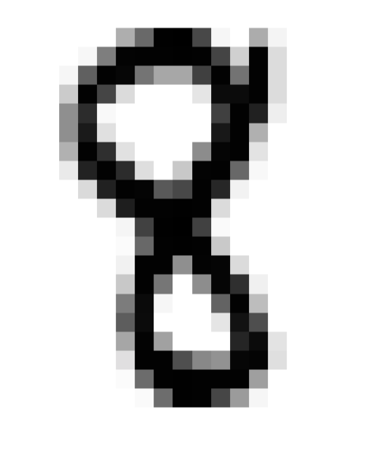
Very simple model: softmax classification
784 pixels
28x28 pixels
...
weighted sum of all pixels + bias
softmax
...
0
1
2
9
neuron outputs
Notes:
Neuron inputs = weighted sum of pixels + biases
Neuron outputs = normalised exponential of inputs (softmax) - the highest value is the recognised digit. Since the values are normalised they are between 0 and 1 and can be interpreted as probabilities. Each one of the 10 output neurons computes the probability of this digit being a 1, a 2, a 3 and so on.
__________________________________________________________________________
Latex equations:
L_n = \sum\limits_{i=0}^{N_{pixels}}{W_{ni}.X_i} + b_n
\\
softmax(L_n) = e^{L_n}/.||e^L||

Slide 6
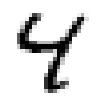

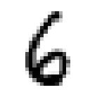
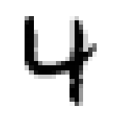
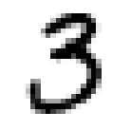
In matrix notation, 100 images at a time
10 columns
w_{0,0} w_{0,1} w_{0,2} w_{0,3} … w_{0,9}
w_{1,0} w_{1,1} w_{1,2} w_{1,3} … w_{1,9}
w_{2,0} w_{2,1} w_{2,2} w_{2,3} … w_{2,9}
w_{3,0} w_{3,1} w_{3,2} w_{3,3} … w_{3,9}
w_{4,0} w_{4,1} w_{4,2} w_{4,3} … w_{4,9}
w_{5,0} w_{5,1} w_{5,2} w_{5,3} … w_{5,9}
w_{6,0} w_{6,1} w_{6,2} w_{6,3} … w_{6,9}
w_{7,0} w_{7,1} w_{7,2} w_{7,3} … w_{7,9}
w_{8,0} w_{8,1} w_{8,2} w_{8,3} … w_{8,9}
…
w_{783,0} w_{783,1} w_{783,2} … w_{783,9}
broadcast
x
784 lines
x
X : 100 images, one per line, flattened
x
x
x
x
x
x
L_{0,0}
L_{1,0} L_{1,1} L_{1,2} L_{1,3} … L_{1,9}
L_{2,0} L_{2,1} L_{2,2} L_{2,3} … L_{2,9}
L_{3,0} L_{3,1} L_{3,2} L_{3,3} … L_{3,9}
L_{4,0} L_{4,1} L_{4,2} L_{4,3} … L_{4,9}
…
L_{99,0} L_{99,1} L_{99,2} … L_{99,9}
… + b₀ b₁ b₂ b₃ … b₉
L_{0,0} L_{0,1} L_{0,2} L_{0,3} … L_{0,9}
Same 10 biases on all lines
784 pixels
Notes:
X is the image, weights W and biases b are learned. Y is the prediction of what a given image represents.
__________________________________________________________________________
Latex equations:
Y = softmax(W.X+b)

Slide 7
Softmax, on a batch of images
Predictions Images Weights Biases
Y[100, 10] X[100, 784] W[784,10] b[10]
broadcast on all lines
applied line by line
matrix multiply
tensor shapes in [ ]
Notes:
We process a batch of 100 images at once. By putting the 100 flattened images into a matrix, we can process all of them with one matrix multiply.
But we have to add the 10 biases to all the lines of the resulting 100x10 matrix. We just write “+” but b gets replicated on all lines using a convention called “broadcasting”: If the + cannot be done because tensor shapes are not compatible, try replicating the second tensor as many times as needed to make them compatible.
Broadcasting semantics: the same in numpy and in tensorflow
__________________________________________________________________________
Latex equations:
Y = softmax(X.W+b)

Slide 8
Now in TensorFlow (Python)
tensor shapes: X[100, 784] W[748,10] b[10]
Y = tf.nn.softmax(tf.matmul(X, W) + b)
broadcast on all lines
matrix multiply
Notes:
This is our “model”

Slide 9
Success ?
0 1 2 3 4 5 6 7 8 9
0
0
0
0
0
0
1
0
0
0
actual probabilities, “one-hot” encoded
Cross entropy:
this is a “6”
computed probabilities
.01
.03
.00
.04
.03
.05
0.8
.02
.01
.01
0 1 2 3 4 5 6 7 8 9
Notes:
How do we know we succeeded ?
The usual loss function used for classification problems is called “cross-entropy”. There is a good explanation here for why it works well. In a nutshell, compared to L2 (sum of squared differences, which we could also use), it puts more distance between results that have a good confidence level (one 0.99 and all others at 0.01 for ex) and results that are weaker (one 0.6 and nine 0.4 output probabilities).
__________________________________________________________________________
Latex equation:
-\sum{Y'_i.log(Y_i)}

Slide 10
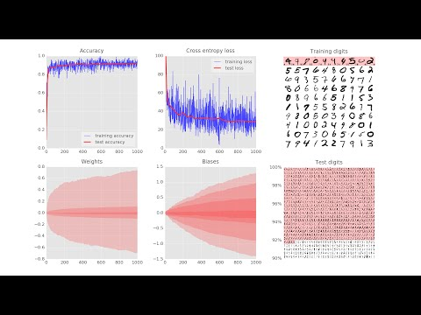
Demo
Notes:
(The live demo allows the speaker to zoom on individual panels while explaining)
All visualisations done using matplotlib, the standard Python visualisation library.
The training digits panel shows the 100 digits fed to the training algorithm at each iteration. In white, those that have been correctly recognised. In red, mismatches. Mismatched digits are labeled with with the correct label on the left and the incorrectly recognised label on the right (tiny digits).
The test digits panel shows 1000 of the 10,000 test digits, unrecognised digits first.
The Weights and Biases histograms show the spread of weights and biases as the learning progresses. Just check that all values remain reasonnable. Otherwise, the algorithm is diverging.
What you can see on the accuracy and the cross-entropy panels is that the training and test values are roughly in lock-step which is good. However, the training accuracy and cross-entropy is very noisy. The training accuracy never approaches 100% and the training loss is stuck at approx. 30. This means that this network does not have the capacity to learn the training set. We need something better.

Slide 11
TensorFlow - initialisation
import tensorflow as tf
X = tf.placeholder(tf.float32, [None, 28, 28, 1])
W = tf.Variable(tf.zeros([784, 10]))
b = tf.Variable(tf.zeros([10]))
init = tf.initialize_all_variables()
this will become the batch size, 100
28 x 28 grayscale images
Training = computing variables W and b
Notes:
Weights and biases (Variables) are what we are trying to compute through deep learning

Slide 12
TensorFlow - success metrics
flattening images
# model
Y = tf.nn.softmax(tf.matmul(tf.reshape(X, [-1, 784]), W) + b)
# placeholder for correct answers
Y_ = tf.placeholder(tf.float32, [None, 10])
# loss function
cross_entropy = -tf.reduce_sum(Y_ * tf.log(Y))
# % of correct answers found in batch
is_correct = tf.equal(tf.argmax(Y,1), tf.argmax(Y_,1))
accuracy = tf.reduce_mean(tf.cast(is_correct, tf.float32))
“one-hot” encoded
“one-hot” decoding
Notes:
Reminder: “one-hot” encoding simply means that the digit “6” is encoded as an array of 10 bits where the 6th bit is 1 and all the others 0

Slide 13
TensorFlow - training
optimizer = tf.train.GradientDescentOptimizer(0.003)
train_step = optimizer.minimize(cross_entropy)
learning rate
loss function
Notes:
Backpropagation algorithm:
Tensorflow computes for you the partial derivatives of the loss function relatively to all weights and biases (the gradient function). At each step, you compute the value of the gradient on the current batch of images, using the current weights and biases and adjust the weights and biases by a fraction of the gradient (this fraction is called the learning rate). Then iterate with next batch of images until you are happy with the result.

Slide 14
TensorFlow - run !
running a Tensorflow computation, feeding placeholders
sess = tf.Session()
sess.run(init)
for i in range(1000):
# load batch of images and correct answers
batch_X, batch_Y = mnist.train.next_batch(100)
train_data={X: batch_X, Y_: batch_Y}
# train
sess.run(train_step, feed_dict=train_data)
# success ?
a,c = sess.run([accuracy, cross_entropy], feed_dict=train_data)
# success on test data ?
test_data={X: mnist.test.images, Y_: mnist.test.labels}
a,c = sess.run([accuracy, cross_entropy], feed=test_data)
Tip:
do this every 100 iterations
Notes:
deferred execution to support GPUs and distributed computing

Slide 15
TensorFlow - full python code
training step
initialisation
import tensorflow as tf
X = tf.placeholder(tf.float32, [None, 28, 28, 1])
W = tf.Variable(tf.zeros([784, 10]))
b = tf.Variable(tf.zeros([10]))
init = tf.initialize_all_variables()
# model
Y=tf.nn.softmax(tf.matmul(tf.reshape(X,[-1, 784]), W) + b)
# placeholder for correct answers
Y_ = tf.placeholder(tf.float32, [None, 10])
# loss function
cross_entropy = -tf.reduce_sum(Y_ * tf.log(Y))
# % of correct answers found in batch
is_correct = tf.equal(tf.argmax(Y,1), tf.argmax(Y_,1))
accuracy = tf.reduce_mean(tf.cast(is_correct,tf.float32))
optimizer = tf.train.GradientDescentOptimizer(0.003)
train_step = optimizer.minimize(cross_entropy)
sess = tf.Session()
sess.run(init)
for i in range(10000):
# load batch of images and correct answers
batch_X, batch_Y = mnist.train.next_batch(100)
train_data={X: batch_X, Y_: batch_Y}
# train
sess.run(train_step, feed_dict=train_data)
# success ? add code to print it
a,c = sess.run([accuracy, cross_entropy], feed=train_data)
# success on test data ?
test_data={X:mnist.test.images, Y_:mnist.test.labels}
a,c = sess.run([accuracy, cross_entropy], feed=test_data)
model
Run
success metrics

Slide 16
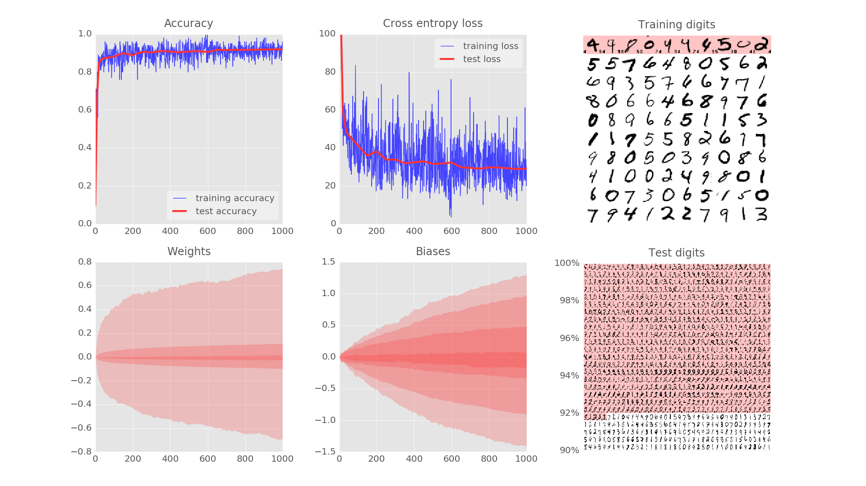
92%
Notes:
Still, getting it right on 92% of the test set with such a simplistic model is quite nice

Slide 17



Softmax
Cross-entropy
Mini-batch
ML
Notes:
What we have learned so far:
Softmax is a good neuron activation function to use when you want to compute classification probabilities.
The usual loss function in that case is the cross-entropy of the predicted classes vs. expected ones.
You can train a neural network on one image or a mini-batch of images. Mini-batching works well.

Slide 18

|
|
Go deep !
|
|
Notes:
How can we progress from here ? The title of this session is “deep learning”, so let us go deep.

Slide 19
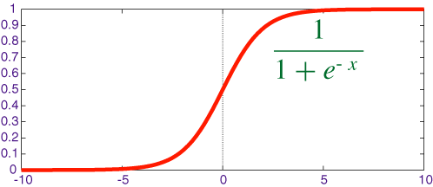
Let’s try 5 fully-connected layers !
;-)
overkill
784
sigmoid
200
100
sigmoid function
60
30
softmax
10
0
1
2
9
...
Notes:
We add more layers to the neural networks.
The last layer keeps its softmax activation function.
For all other neurons, the typical activation function is the sigmoid because it is non-linear, derivable, and goes from 0 (neuron not active) to 1 (neuron active).
Let us try lots of layers and lots of neurons to see what happens.

Slide 20
TensorFlow - initialisation
weights initialised with random values
K = 200
L = 100
M = 60
N = 30
W1 = tf.Variable(tf.truncated_normal([28*28, K] ,stddev=0.1))
B1 = tf.Variable(tf.zeros([K]))
W2 = tf.Variable(tf.truncated_normal([K, L], stddev=0.1))
B2 = tf.Variable(tf.zeros([L]))
W3 = tf.Variable(tf.truncated_normal([L, M], stddev=0.1))
B3 = tf.Variable(tf.zeros([M]))
W4 = tf.Variable(tf.truncated_normal([M, N], stddev=0.1))
B4 = tf.Variable(tf.zeros([N]))
W5 = tf.Variable(tf.truncated_normal([N, 10], stddev=0.1))
B5 = tf.Variable(tf.zeros([10]))
Notes:
To break the symmetry of the neurons, we seed the weights with random values at the beginning.

Slide 21
TensorFlow - the model
weights and biases
X = tf.reshape(X, [-1, 28*28])
Y1 = tf.nn.sigmoid(tf.matmul(X, W1) + B1)
Y2 = tf.nn.sigmoid(tf.matmul(Y1, W2) + B2)
Y3 = tf.nn.sigmoid(tf.matmul(Y2, W3) + B3)
Y4 = tf.nn.sigmoid(tf.matmul(Y3, W4) + B4)
Y = tf.nn.softmax(tf.matmul(Y4, W5) + B5)
Notes:
One layered neural network = one line model in Tensorflow
Five layers = five lines for the model

Slide 22
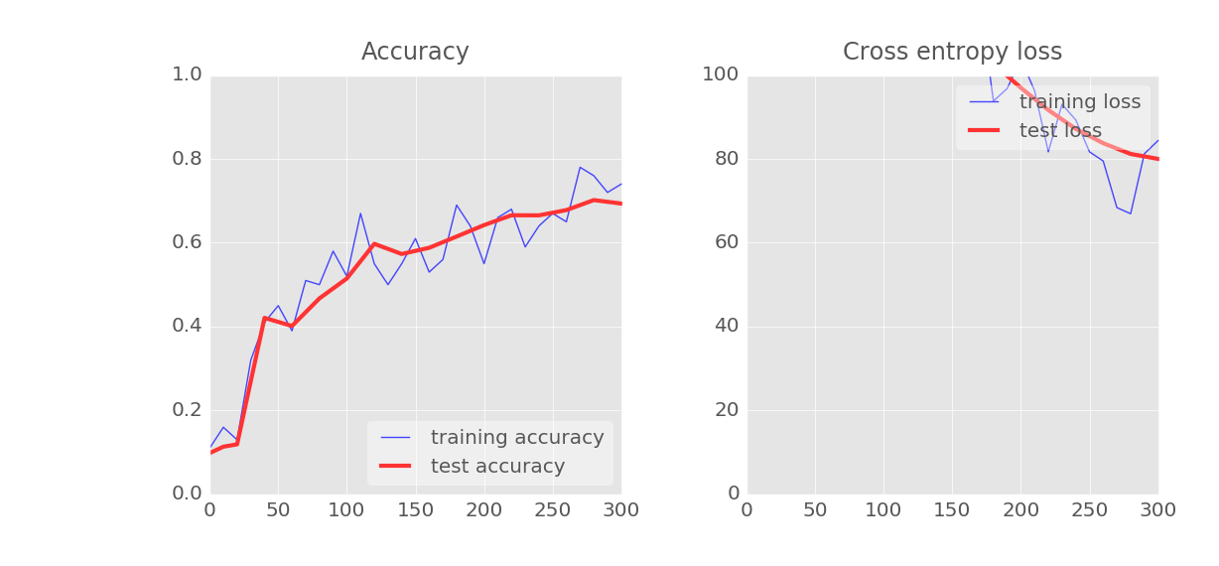
slow start ?
Notes:
Live demo: it works, but the start is kind of slow. At 300 iterations, we are still below 80% accuracy and the cross-entropy is very high. It will eventually get there but there is a better way.

Slide 23

Relu !

Slide 24
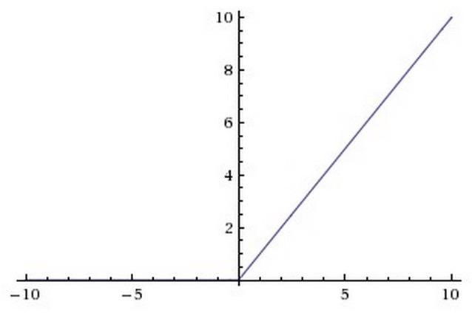
RELU
RELU = Rectified Linear Unit
Y = tf.nn.relu(tf.matmul(X, W) + b)
Notes:
This activation function is also non-linear, derivable (apart from one point, zero, but that’s OK if you are not a mathematician). It’s kind of simplistic but there is evidence that biological neurons work more like relus rather than sigmoids. Whatever, scientists tried this function and it works better. Why ? Well, some people will tell you that the sigmoid squashes all values between zero and one which can lead to a “vanishing gradient” problem. That’s a bummer when you count on the gradient to show you the direction. But I have not seen a really good explanation yet. People just tried it and adopted it.
When using RELUs, do not forget to initialise biases to positive values, otherwise the RELUs would be dead from the start.

Slide 25
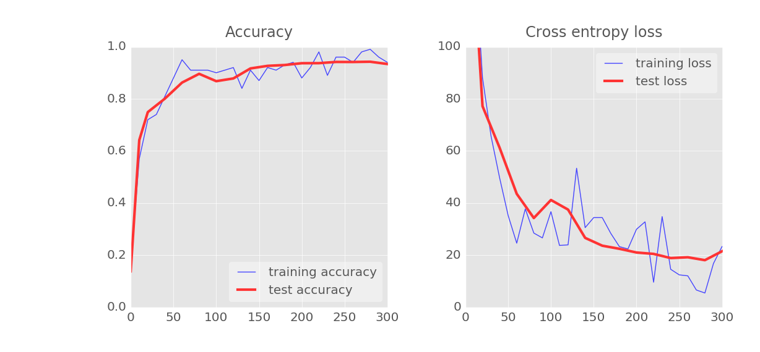
RELU
Notes:
With RELUs, we are back to normal, even with a deep network. It will shoot through the 80% accuracy bar in its first 40 iterations.

Slide 26
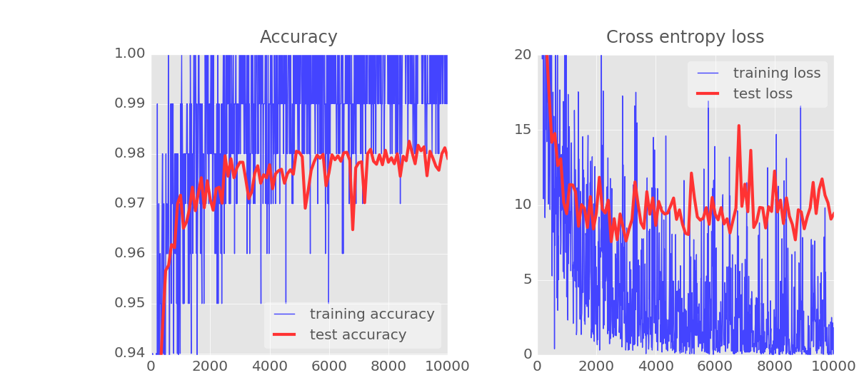
Demo - noisy accuracy curve ?
yuck!
Notes:
Live demo: these curves are really noisy. It looks like we are pushing the optimizer too hard and that it has a hard time settling down in a minimum of the loss function. The learning rate must be too high. But if we decrease it, learning will be much slower. Idea: decrease it progressively during the run.

Slide 27

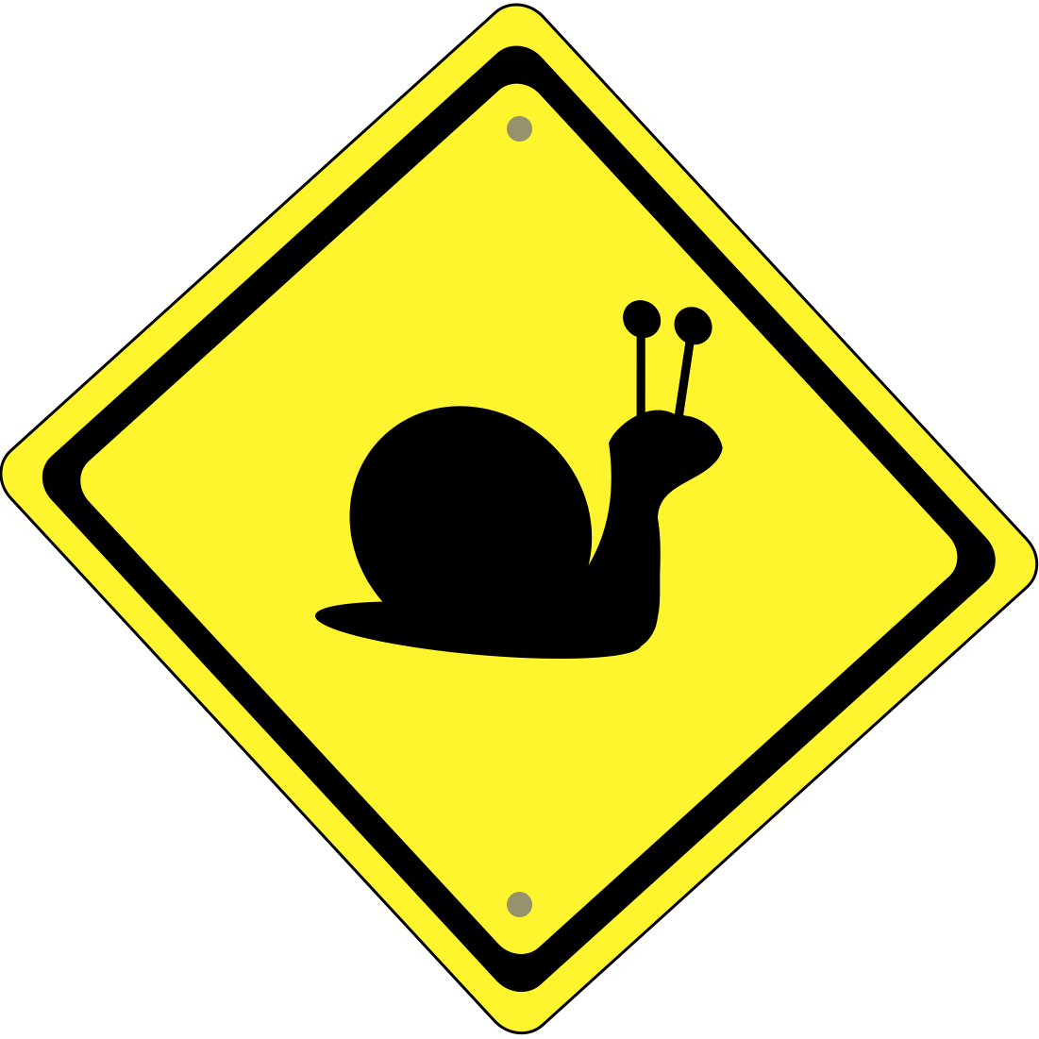
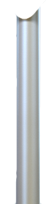
Slow down . . .
Learning rate decay

Slide 28
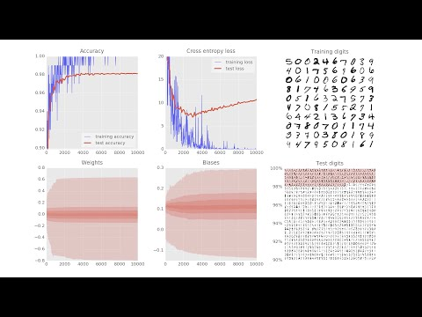
Demo
Notes:
TODO: re-take this video with weights/biases
We see much better overall performance here. Training accuracy now goes all the way to 100%. All training digits have been learned. Training cross-entropy is almost at 0. Test cross entropy is in the 5-10 region. Remember we could not get them below 30 with the previous network.
98% test accuracy in the end. Good, but still hard to use in production when 2 digits are mis-recognised out of every 100 digits…
And this difference between the test and training cross-entropy is weird ...

Slide 29
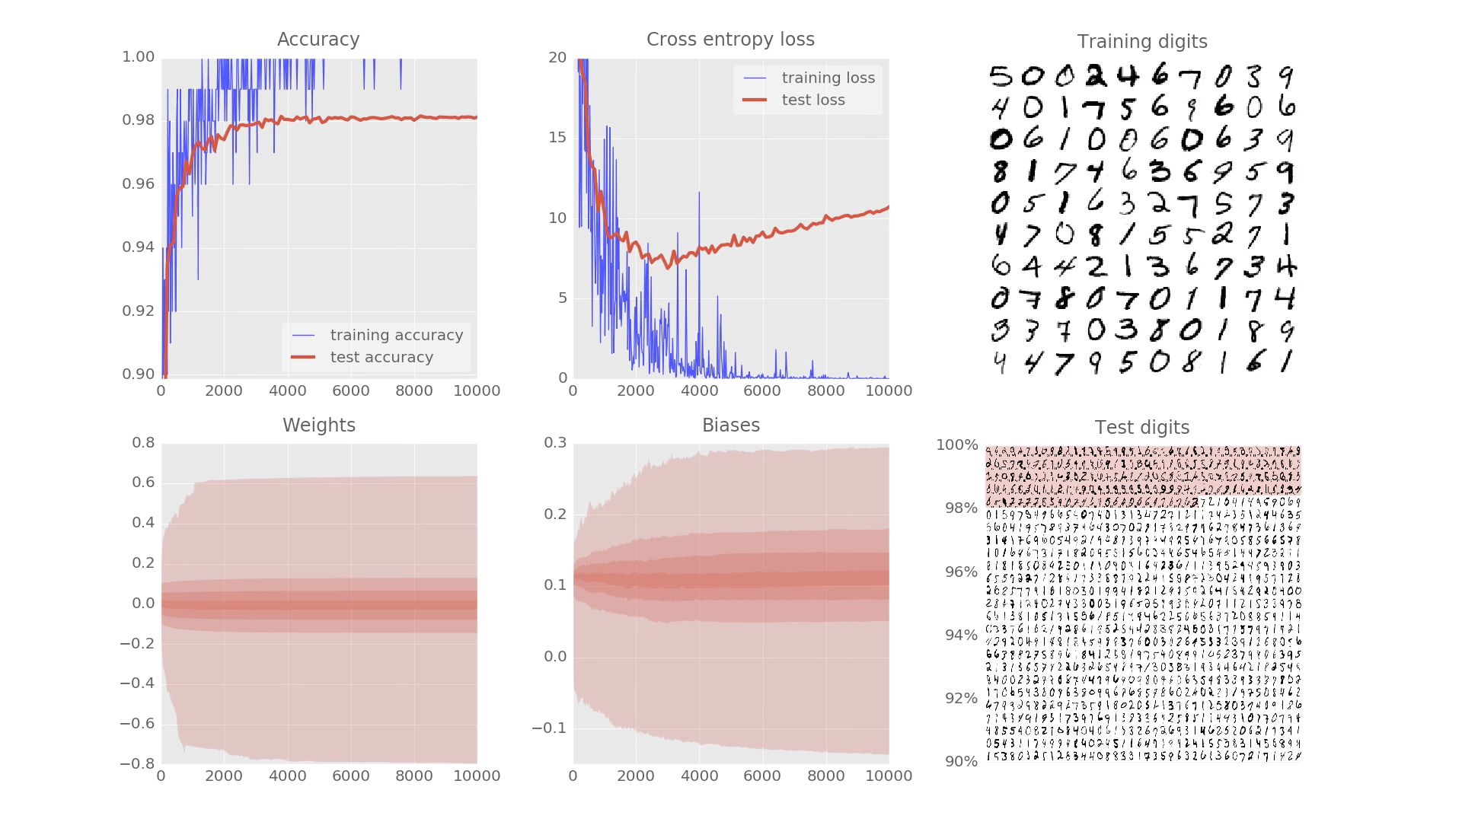
98%

Slide 30
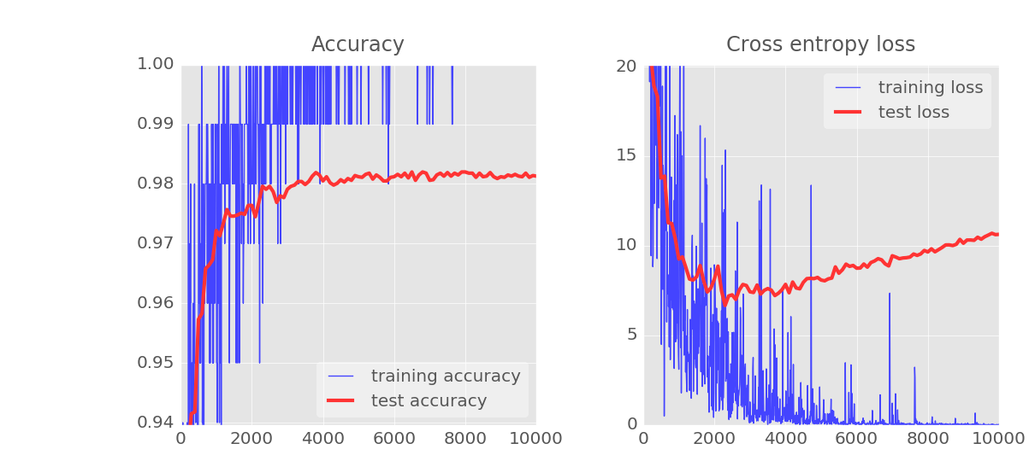
Learning rate decay
Learning rate 0.003
Learning rate 0.003 at start then dropping exponentially to 0.0001
Notes:
Learning rate decay really cleans up the curves in a spectacular way and gets us a training accuracy of 100% sustained over several epochs: for the first time, we have been able to learn all of our training examples perfectly. It does not mean perfect accuracy on real-world data, but it’s a good start.

Slide 31
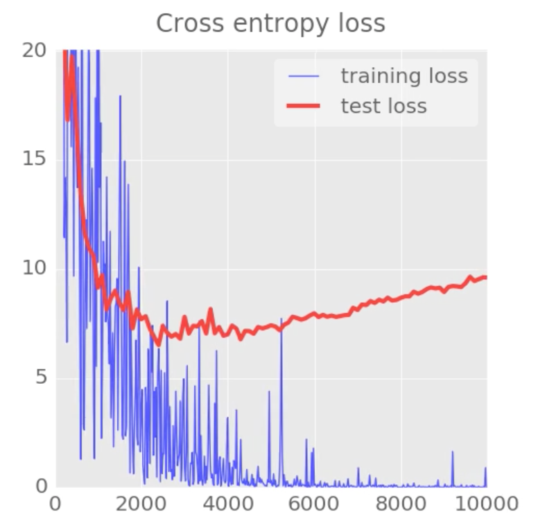
Overfitting
Cross-entropy loss
Overfitting ?
Notes:
TODO: explain why this discrepancy is always there, but with different strength
What is going on ? The system is getting better and better on training data but performance on test data is not improving anymore ?!?
Let us firts try the textbook solution for when this happens: dropout

Slide 32

Dropout
Notes:
What can we do about our dying neurons ?
Shoot them to make them die faster !

Slide 33
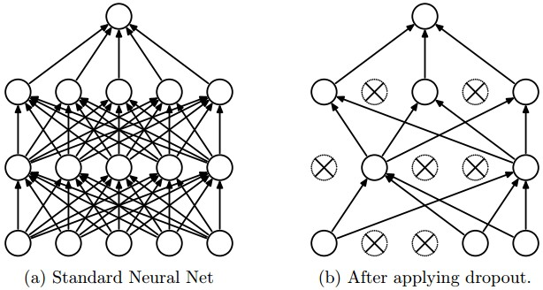
Dropout
pkeep = tf.placeholder(tf.float32)
TRAINING
rate=0.5
EVALUATION rate=0
Yf = tf.nn.relu(tf.matmul(X, W) + B)
Y = tf.nn.dropout(Yf, pkeep)
Notes:
The dropout technique effectively removes a proportion of our neurons from the network at random at each iteration. Outputs of the remaining neurons are boosted accordingly so as not to reduce the intensity of the signal flowing to the next layer, which would shift neuron activations. When testing, all neurons are put back.
It has many benefits that we will demonstrate shortly.

Slide 34
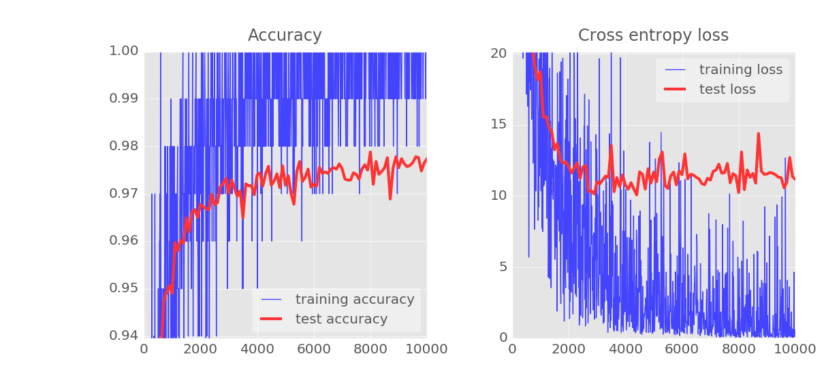
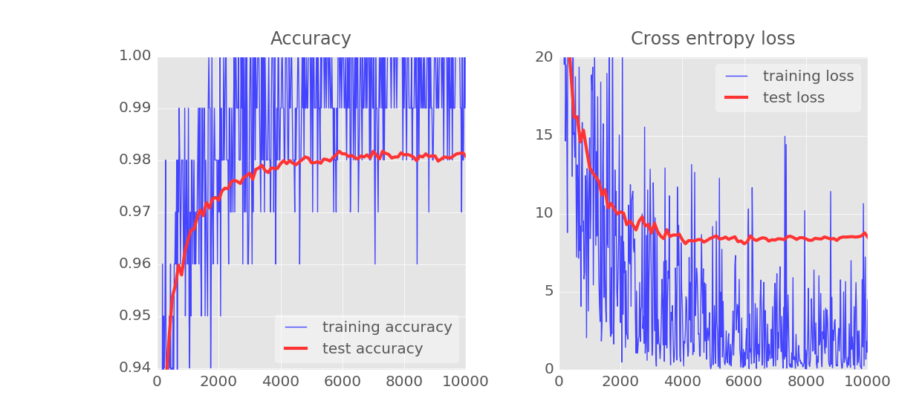
All the party tricks
98.2%
sustained
97.9%
98.2%
peak
Sigmoid, learning rate = 0.003
RELU, learning rate = 0.003
RELU, decaying learning rate 0.003 -> 0.0001
RELU, decaying learning rate 0.003 -> 0.0001 and dropout 0.75
Notes:
We have replaced sigmoids with RELUs to get stronger gradients and a faster convergence
Then we have applied a decaying learning rate to make the convergence more stable
Finally, dropout seems to alleviate the problem of the test cross-entropy going up again, but at the cost of some noise.
Whatever we do, the 98% barrier is hard to break though...

Slide 35
Overfitting
Cross-entropy loss
Overfitting
Notes:
What is going on ? The system is getting better and better on training data but performance on test data is not improving anymore ?!? Let’s ask the experts.

Slide 36




Overfitting ?!?
Too many neurons
BAD Network
Not enough DATA
Notes:
(TODO) feedback: picture of overfitting ?
“Overfitting” usually means that your neural network has learned all the training examples in a “dumb” way, which does not help it categorize examples that it has not seen during training. For example, with really many neurons, it could simply store a copy of every training image. But that would not work on real-world data.
When you see the test and training loss de-coupling, it means that the training algorithm is now working on optimizing the loss on the training data but this no longer has an effect on real-world classification performance. It can be because you have too many neurons, allowing the network to “learn examples by heart” without learning to generalize them. It can be because you do not have enough data. Or it can be that you current neural network architecture is simply not good enough to extract the relevant information from the training data.
In our case it’s actually the latter. We could reduce the number of neurons without affecting performance (remember, they were dying en masse anyway) but it would not increase the final classification accuracy significantly.
We have to realise that we are throwing good information away. By flattening our images into a single line of pixels, we lose shape information, and shapes are what handwritten digits are all about ! Let’s fix that.

Slide 37
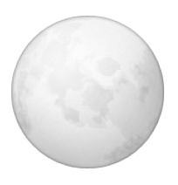
Convolutional layer
convolutional
subsampling
+padding
convolutional
subsampling
convolutional
subsampling
stride
W₁[4, 4, 3]
W[4, 4, 3, 2]
W₂[4, 4, 3]
filter size
input channels
output channels
Notes:
We will now scan the image (here a color image, in the general case) with small “patch” of weights, still doing a weighted sum, adding a bias and feeding the result through a nonlinear activation function. This “patch” is the same for all neurons in the layer. It’s a kind of feature recogniser. By padding the image we can get as many outputs as pixels in the original image.
But now we have drastically reduced our number of weights, so let’s do this convolution again, with another “patch” of weights and a bias. That’s another output image. Let’s us place it below the first one. We can repeat this as many times as we want.
In the end, a “convolutional layer” transforms a layered image with N channels into another layered image with P channels. As a consequence, convolutional layers can be chained.
But we still have a problem, down the line, we want just 10 values (our 10 categories 0, 1, ...9) so we also need to condense the information in some way.
In classic neural network literature, a convolutional neural network will alternate convolutional and subsampling (maxpool) layers. The intuitive idea is that applying the “patch” (the convolution) will identify some features and we then subsample the output by keeping only outputs where the signal is strongest let’s say on blocks of 2x2 neurons (max-pooling).
But subsampling can also be achieved by using a regular convolutional layer with a stride > 1. That’s what everyone does today.

Slide 38

Hacker’s tip
ALL Convolu- tional

Slide 39
Convolutional neural network
+ biases on all layers
28x28x1
convolutional layer, 4 channels W1[5, 5, 1, 4] stride 1
28x28x4
convolutional layer, 8 channels W2[4, 4, 4, 8] stride 2
14x14x8
convolutional layer, 12 channels W3[4, 4, 8, 12] stride 2
7x7x12
200
fully connected layer W4[7x7x12, 200]
10
softmax readout layer W5[200, 10]
Notes:
After the convolutional layers, we give the neural network some thinking freedom by adding a fully-connected layer and the classic softmax readout layer.
The activation function is still RELU apart from the last layer (softmax)

Slide 40
Tensorflow - initialisation
filter size
input channels
output channels
K=4
L=8
M=12
W1 = tf.Variable(tf.truncated_normal([5, 5, 1, K] ,stddev=0.1))
B1 = tf.Variable(tf.ones([K])/10)
W2 = tf.Variable(tf.truncated_normal([5, 5, K, L] ,stddev=0.1))
B2 = tf.Variable(tf.ones([L])/10)
W3 = tf.Variable(tf.truncated_normal([4, 4, L, M] ,stddev=0.1))
B3 = tf.Variable(tf.ones([M])/10)
N=200
W4 = tf.Variable(tf.truncated_normal([7*7*M, N] ,stddev=0.1))
B4 = tf.Variable(tf.ones([N])/10)
W5 = tf.Variable(tf.truncated_normal([N, 10] ,stddev=0.1))
B5 = tf.Variable(tf.zeros([10])/10)
weights initialised with random values
Notes:
Let’s initialise all our weights and biases. You can see the “patch” size as well as its input and output depth in the shape of each Wn tensor.

Slide 41
Tensorflow - the model
input image batch X[100, 28, 28, 1]
weights
stride
biases
Y1 = tf.nn.relu(tf.nn.conv2d(X, W1, strides=[1, 1, 1, 1], padding='SAME') + B1)
Y2 = tf.nn.relu(tf.nn.conv2d(Y1, W2, strides=[1, 2, 2, 1], padding='SAME') + B2)
Y3 = tf.nn.relu(tf.nn.conv2d(Y2, W3, strides=[1, 2, 2, 1], padding='SAME') + B3)
YY = tf.reshape(Y3, shape=[-1, 7 * 7 * M])
Y4 = tf.nn.relu(tf.matmul(YY, W4) + B4)
Y = tf.nn.softmax(tf.matmul(Y4, W5) + B5)
Y3 [100, 7, 7, 12]
flatten all values for fully connected layer
YY [100, 7x7x12]
Notes:
The model. After the three convolutional layers, we have a 7x7x12 “cube” of data which we flatten into a single vector in order to feed it into a fully connected layer.
The syntax for specifying the “stride” in the conv2d function is a bit weird because it allows for depth strides as well. We are not using that, only strides in the x and y directions (in red).

Slide 42
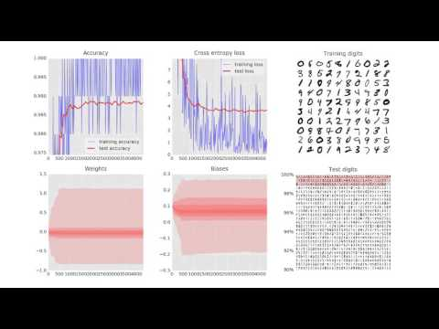
Demo
Notes:
Here we have to zoom on the accuracy and cross-entropy graphs to see something. The training set is fully learned! At the end, training accuracy is at 100% for many iterations and the training loss drops below 1 !
Test accuracy almost touches the 99% bar but for some reason, it cannot break this ceiling.

Slide 43
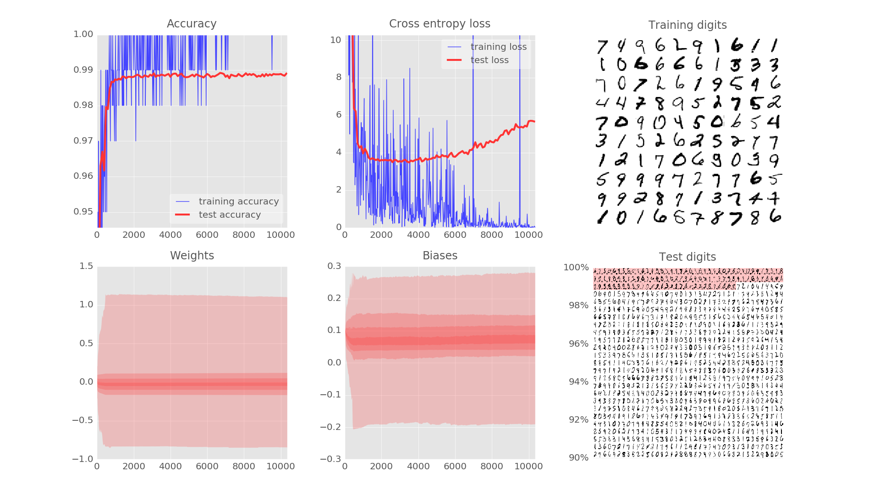
98.9%
Notes:
But something fishy is going on: after 2000 iterations, the test cross-entropy is going up again ???
98.9% test accuracy in the end is not bad but we want to get past 99 !

Slide 44
WTFH ???
???
Notes:
Training examples fully learned. 50K training digits, training with 100 digits per iteration => 1 epoch, is 500 iterations. Here we see a training accuracy of 100% across multiple epochs. But test cross-entropy going up ? The network is optimising it’s training cross-entropy further and further towards 0 but that has no connection to the test examples anymore.
What can we do ?

Slide 45
+ dropout
Bigger convolutional network
+ biases on all layers
28x28x1
convolutional layer, 6 channels W1[6, 6, 1, 6] stride 1
convolutional layer, 6 channels W1[6, 6, 1, 6] stride 1
28x28x6
convolutional layer, 12 channels W2[5, 5, 6, 12] stride 2
convolutional layer, 12 channels W2[5, 5, 6, 12] stride 2
14x14x12
convolutional layer, 24 channels W3[4, 4, 12, 24] stride 2
convolutional layer, 24 channels W3[4, 4, 12, 24] stride 2
7x7x24
+DROPOUT p=0.75
200
fully connected layer W4[7x7x24, 200]
10
softmax readout layer W5[200, 10]
Notes:
We increase patch sizes from 5x5, 4x4, 4x4 to 6x6, 5x5, 4x4
We increase the number of channels in each convolutional layer. Previously our three layers had 4, 8 and 12 channels. We now go for 6, 12 and 24 channels.
Four 5x5 feature recognising patches in the first layer simply wasn’t enough.
And, to fight the creeping test loss, we add dropout in the fully-connected layer.

Slide 46
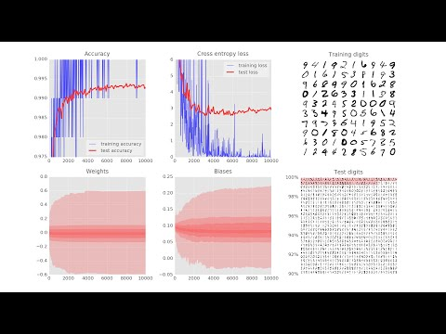
Demo
Notes:
Test accuracy now hovers confidently in the 99.3 % region and even peaks at 99.38% !
99% barrier shattered.
The test cross-entropy still goes up slightly after 4000 iterations but nowhere as badly as previously.

Slide 47
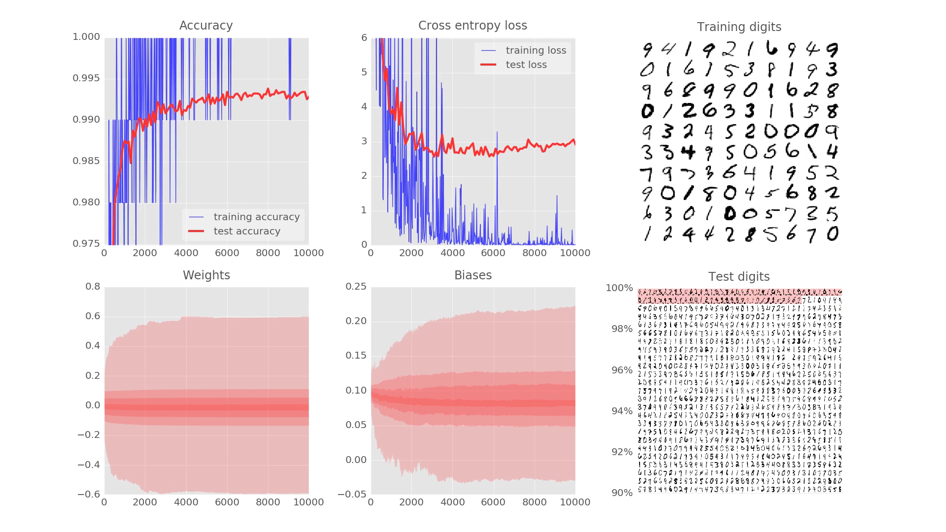
99.3%
Notes:
We end up at 99.3% test accuracy. The world record is 99.77%. Paper linked from the MNIST web site: http://yann.lecun.com/exdb/mnist/
This run also added proper learning rate decay

Slide 48
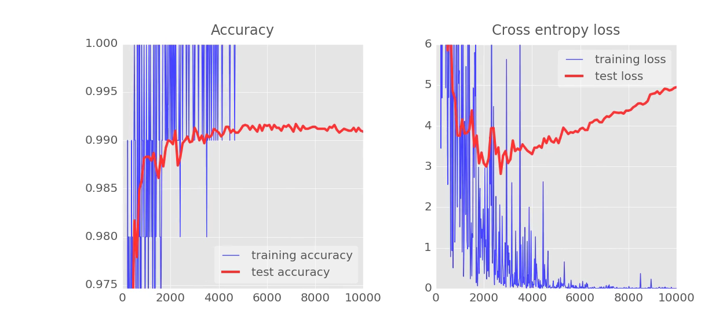
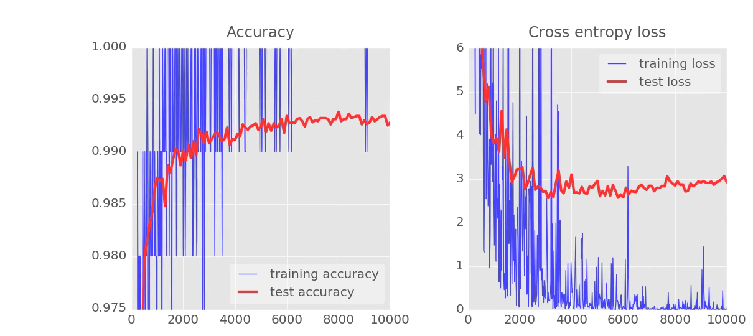
YEAH !
with dropout
Notes:
Test loss creep under control with dropout.

Slide 49
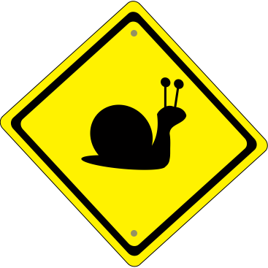
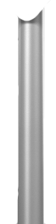
Learning rate decay
Relu !
Dropout
Softmax
Cross-entropy
Mini-batch
ALL Convolu- tional
Go deep
Overfitting ?!?
Too many neurons
|
|
BAD Network
Not enough DATA
Cartoon images copyright: alexpokusay / 123RF stock photos
Notes:
Recap’
Cartoon images copyright: alexpokusay / 123RF stock photos

Slide 50
Slides Downloadable Link
https://docs.google.com/presentation/d/1B_ft3b1oLluOAOO2HzsvLwbN8fn1PzF4Kx44LF8P4Q0/edit?usp=sharing

